Slide 1

IN432
Advanced Web Programming

Slide 2
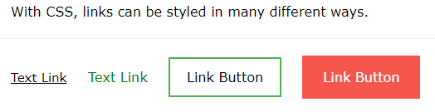
CSS Links
Links can be styled with any CSS property (e.g. color, font-family, background, etc.).
In addition, links can be styled differently depending on what state they are in.
The four links states are:
a:link - a normal, unvisited link
a:visited - a link the user has visited
a:hover - a link when the user mouses over it
a:active - a link the moment it is clicked

Slide 3
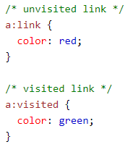
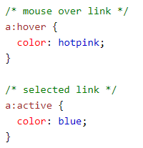
CSS Links

Slide 4



CSS Links
Text Decoration
The text-decoration property is mostly used to remove underlines from links:

Slide 5
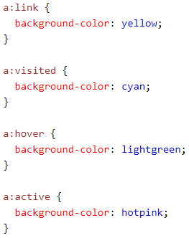
CSS Links
Background Color
The background-color property can be used to specify a background color for links:

Slide 6
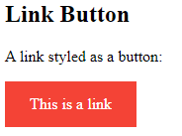
CSS Links
Link Buttons
a:link, a:visited {
background-color: #f44336;
color: white;
padding: 14px 25px;
text-align: center;
text-decoration: none;
display: inline-block;
}
a:hover, a:active {
background-color: red;
}
<body>
<h2>Link Button</h2>
<p>A link styled as a button:</p>
<a href=“index.html" target="_blank">This is a link</a>
</body>

Slide 7

CSS Links
Link Buttons
a:link, a:visited {
background-color: white;
color: black;
border: 2px solid green;
padding: 10px 20px;
text-align: center;
text-decoration: none;
display: inline-block;
}
a:hover, a:active {
background-color: green;
color: white;
}
<body>
<a href="default.asp" target="_blank">This is a link</a>
</body>

Slide 8

CSS Links
CSS Navigation Bar
Navigation Bar = List of Links
<ul>
<li><a href="default.asp">Home</a></li>
<li><a href="news.asp">News</a></li>
<li><a href="contact.asp">Contact</a></li>
<li><a href="about.asp">About</a></li>
</ul>
Home
News
Contact
About
Removing the bullets :
ul {
list-style-type: none;
margin: 0;
padding: 0;
}

Slide 9
CSS Links
CSS Vertical Navigation Bar
ul {
list-style-type: none;
margin: 0;
padding: 0;
width: 200px;
background-color: #f1f1f1;
}
li a {
display: block;
color: #000;
padding: 8px 16px;
text-decoration: none;
}
/* Change the link color on hover */
li a:hover {
background-color: #555;
color: white;
}
<body>
<h2>Vertical Navigation Bar</h2>
<ul>
<li><a href="#home">Home</a></li>
<li><a href="#news">News</a></li>
<li><a href="#contact">Contact</a></li>
<li><a href="#about">About</a></li>
</ul>
</body>

Slide 10
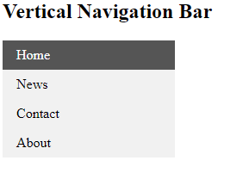
CSS Links
CSS Vertical Navigation Bar
<body>
<h2>Vertical Navigation Bar</h2>
<ul>
<li><a href="#home">Home</a></li>
<li><a href="#news">News</a></li>
<li><a href="#contact">Contact</a></li>
<li><a href="#about">About</a></li>
</ul>
</body>
ul {
list-style-type: none;
margin: 0;
padding: 0;
width: 200px;
background-color: #f1f1f1;
}
li a {
display: block;
color: #000;
padding: 8px 16px;
text-decoration: none;
}
/* Change the link color on hover */
li a:hover {
background-color: #555;
color: white;
}

Slide 11
CSS Links
CSS Vertical Navigation Bar
Vertical Navigation Bar Examples
Check CSCI390Week04_L02_Example01
Check CSCI390Week04_L02_Example02
Check CSCI390Week04_L02_Example03

Slide 12
CSS Links
CSS Horizontal Navigation Bar
One way to build a horizontal navigation bar is to specify the <li> elements as inline, in addition to the "standard" code:
li {
display: inline;
}
Horizontal Navigation Bar Examples
Check CSCI390Week04_L02_Example04
Check CSCI390Week04_L02_Example05
Check CSCI390Week04_L02_Example06
Check CSCI390Week04_L02_Example07
Check CSCI390Week04_L02_Example08

